Slide 1
Diving Deep into PoolTogether
A Micro Grant Funded Project

Slide 2

What is PoolTogether and why are we pooling together?
PoolTogether is a fun, open sourced and decentralized protocol for “no-loss” lotteries where users transfer their crypto into a shared pool that acts as a “prize-linked savings account”. These deposits double as lottery tickets that give the depositor a chance to win proportional to the amount of the pool they claim. Just like traditional savings accounts, all money in the pool earns a yield and each user can withdraw at their discretion.
At the time of this writing, $3,801,856 worth of prizes have been awarded. [1] Also, based on current deposits, the platform has been generating $93,558 in interest per week for its users. [2]
Interested in earning? You can participate in PoolTogether on the Ethereum, xDai, Matic, and Binance Smart Chain networks.
Notes:
https://duneanalytics.com/sarfang/pooltogetherv3
https://pooltogether.com/

Slide 3
Incentive Aligned Coordination via Governance
True to the spirit of decentralization, the PoolTogether protocol is managed by holders of the $POOL governance token who draft and vote on proposals that control the prize creation tools and prize pools.
Proposals are ratified through a voting process and are then implemented by the community.

Slide 4
Swimming Through the Data Pools
Talk about them generating data
They have dune dashboard
Omni analytics got a grant to show the data in a different light

Slide 5
Analytics and the Technicals
Using R
Ggplot

Slide 6
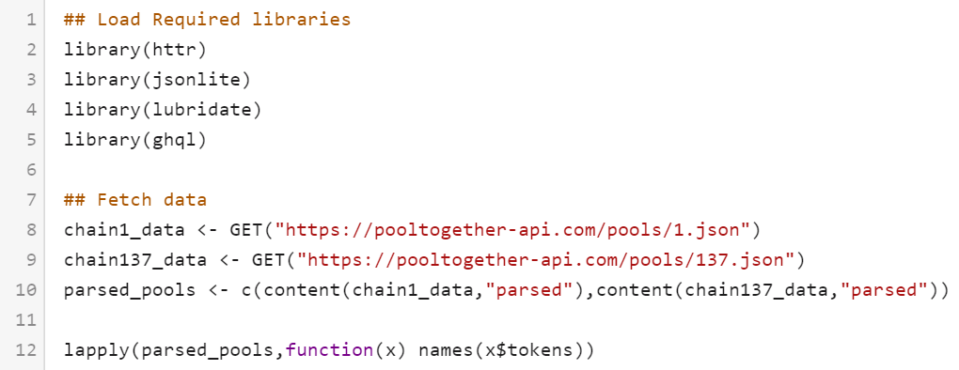
Collecting Pool Samples
We basically decoded the https://app.pooltogether.com webpage, And tapped into the data sources the page uses.
10:54
The page first loads the pool lists from chain specific links
Eth : https://pooltogether-api.com/pools/1.json
Polygon : https://pooltogether-api.com/pools/137.json,
It contains most of the basic variables like
We basically decoded the https://app.pooltogether.com webpage, And tapped into the data sources the page uses.
10:54
The page first loads the pool lists from chain specific links Eth : https://pooltogether-api.com/pools/1.json Polygon : https://pooltogether-api.com/pools/137.json, It contains most of the basic variables like

Slide 7
Collecting Pool Samples
Then for collecting the past prizes and ticket holders of a specific pool we go the subgraphs for same every pool can be linked to a different version of the subgraph we take the subgraph version from the basic data above and talk to that subgraph further.
For the historical prize data we tap into prizePool->prize query
For the holder data we tap into controlledTokenBalances
Here is an screenshot of pool basic data, reward history data, holders data for UNI pool at the time of scrape.
We basically decoded the https://app.pooltogether.com webpage, And tapped into the data sources the page uses.
10:54
The page first loads the pool lists from chain specific links Eth : https://pooltogether-api.com/pools/1.json Polygon : https://pooltogether-api.com/pools/137.json, It contains most of the basic variables like

Slide 8
data
We also know this because information about each pool is contained in the pools_data.RDS file
The holders data contains the wallet addresses and deposits of every pool participant at the time of the snapshot

Slide 9
- 7867 unique wallet deposits at the time of this snapshot- 18.8% (1476) of pooltogether participants play in more than one pool - 81.2% (6391) of all pooltogether players participate on only 1 pool - 2 wallets had deposits in 7 of the 13 available pools(edited)[10:18 AM]
https://etherscan.io/address/0x0c6ac3fcea667fd6c62483ce1dbbce6f6ce0fb1f https://etherscan.io/address/0xe2f6e3565a96cd24d6ba985563a26fb3c93cad04

Slide 10
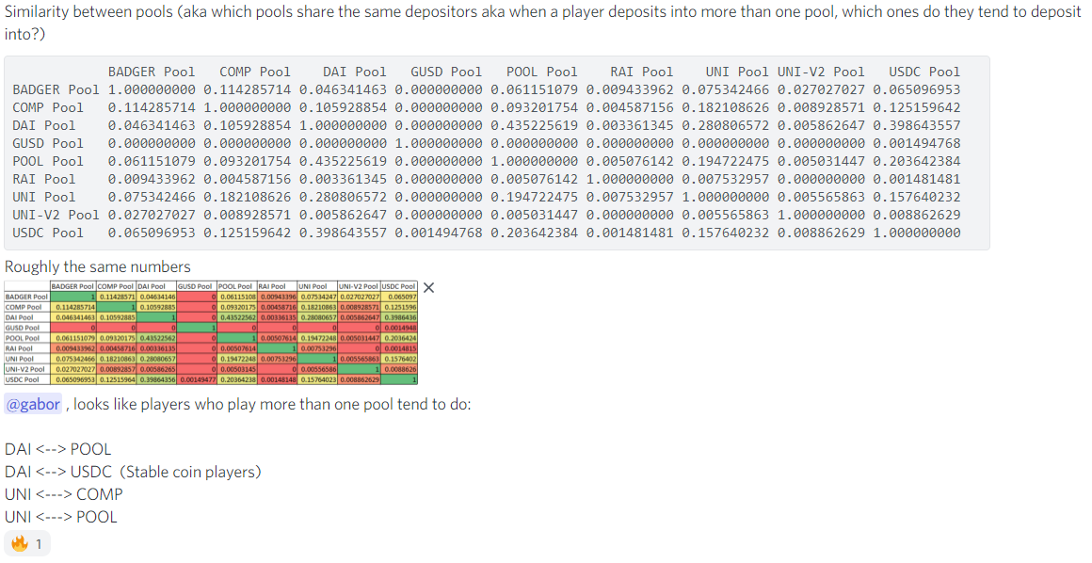
Pool similarity

Slide 11
Time between drawings
> mean(rewards_data$TimeBetween, na.rm = TRUE)
[1] 44.00217
> median(rewards_data$TimeBetween, na.rm = TRUE)
[1] 25.42806
The median and mean time between any reward / drawing is 44 hours and 25 hours
so basically there is a drawing everyday on the platform
The time between rewards is decreasing overtime, which means that as pooltogether adds pools players have more chances to win.
Makes for a more interesting game

Slide 12
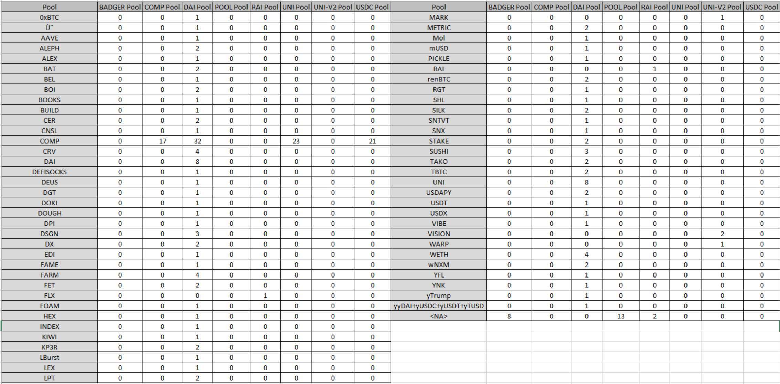

Slide 14
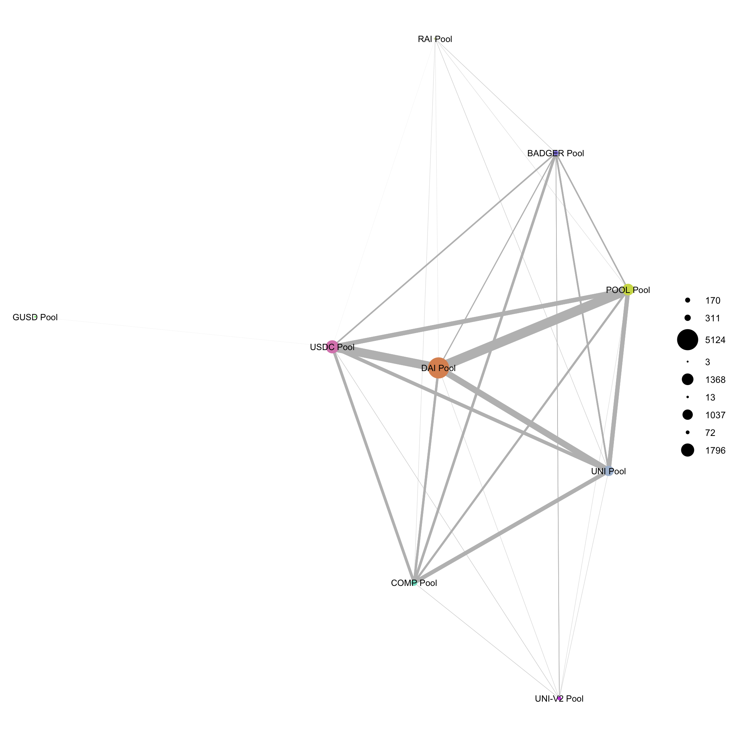
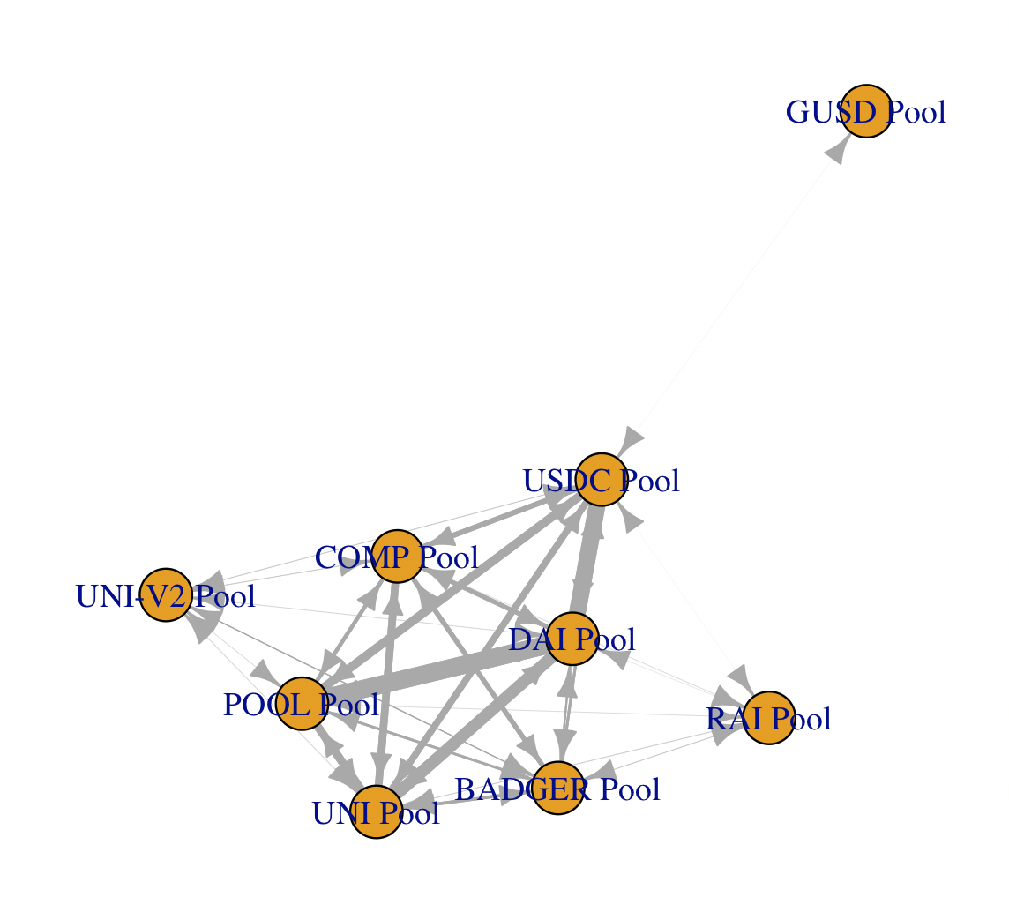
Hey @gabor we can earn a few FF tokens by coming up with guide for them to setup their own prize pool using the Prize Pool Builder. Is this something you'd be interested in?

Slide 15
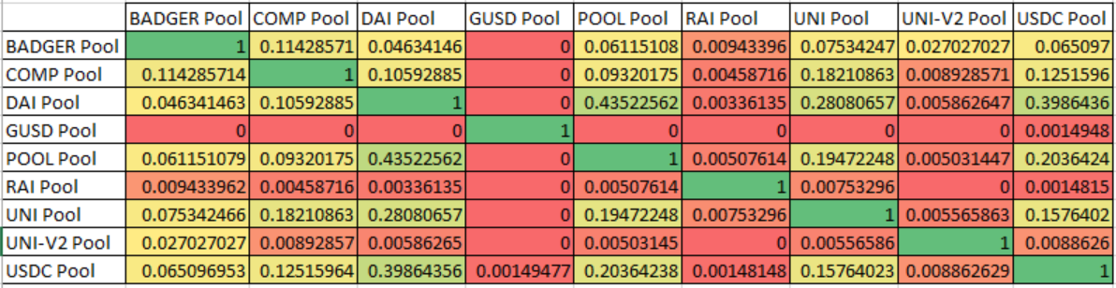
Hey @gabor we can earn a few FF tokens by coming up with guide for them to setup their own prize pool using the Prize Pool Builder. Is this something you'd be interested in?

Slide 16
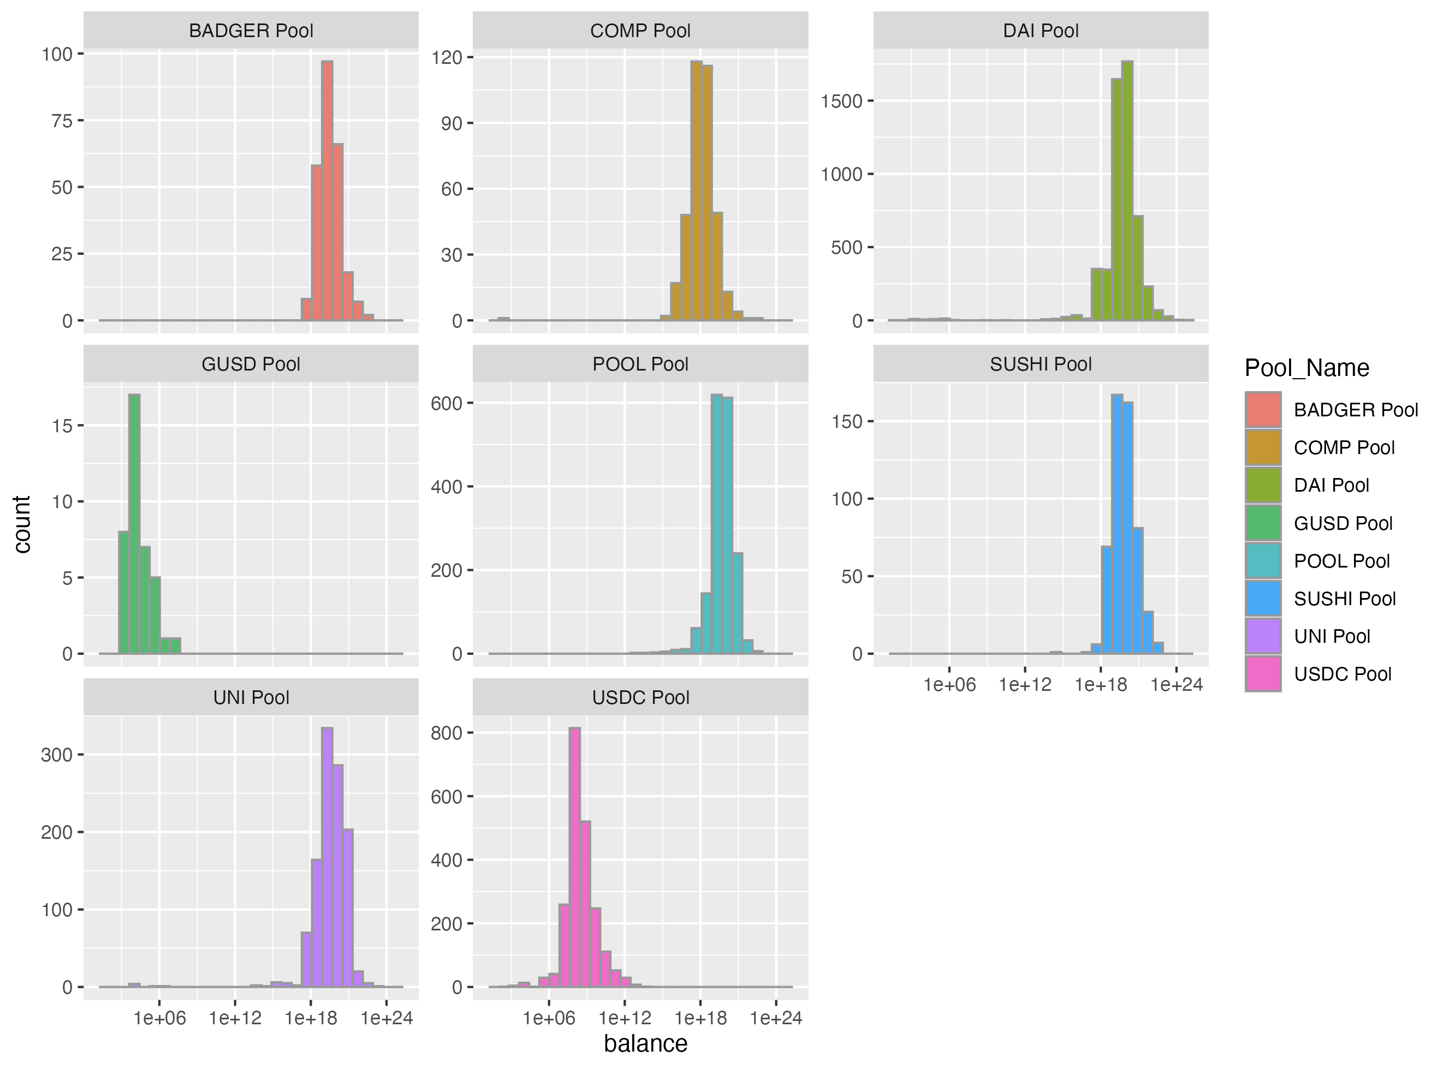

Slide 17
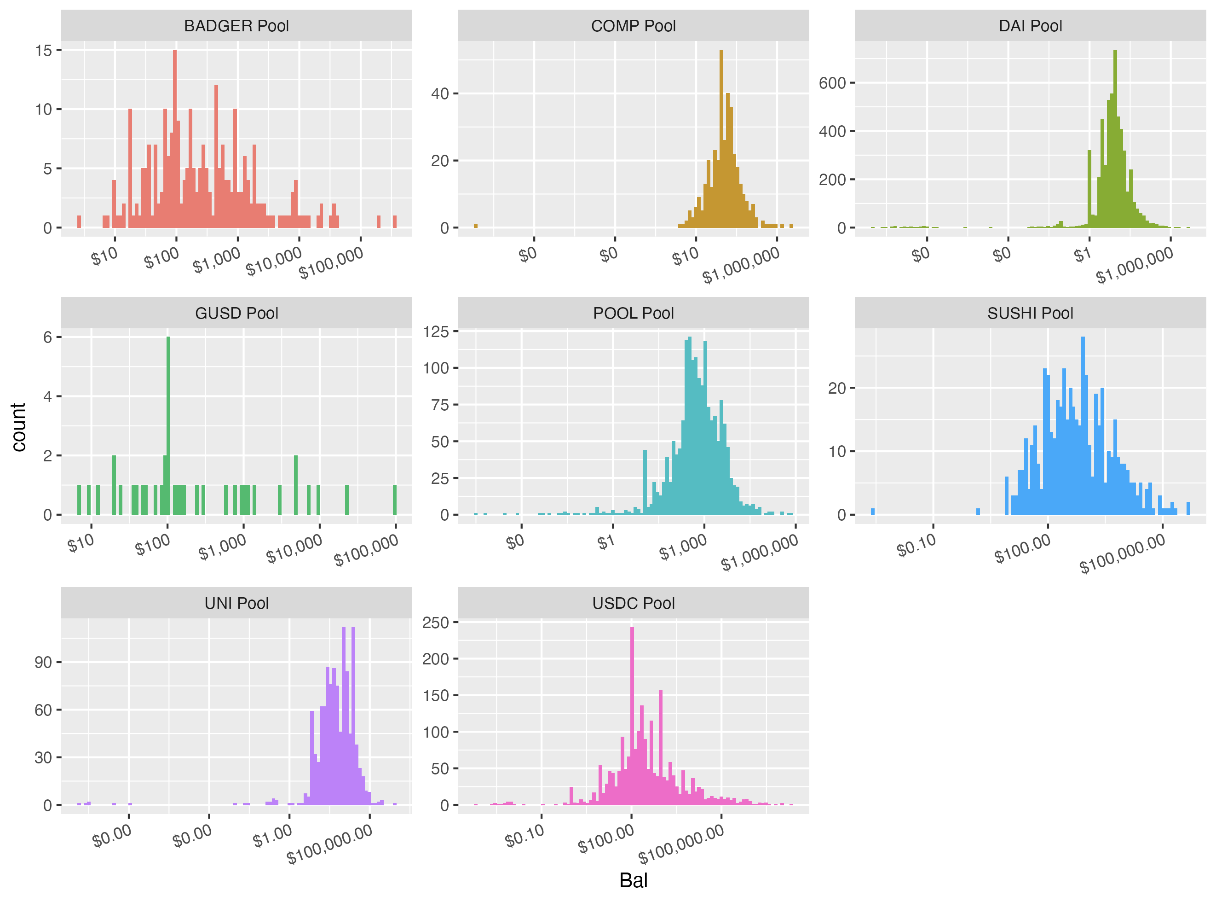

Slide 19
Histograms of the number of tokens and the cash equivalent balances of the individual wallets inside of each pool. One interesting take away (that is actually found in quite a lot of data like this) is the fact that there are spikes at rounded numbers. Here it seems that $100 is a very popular amount to deposit within a pool.

Slide 20
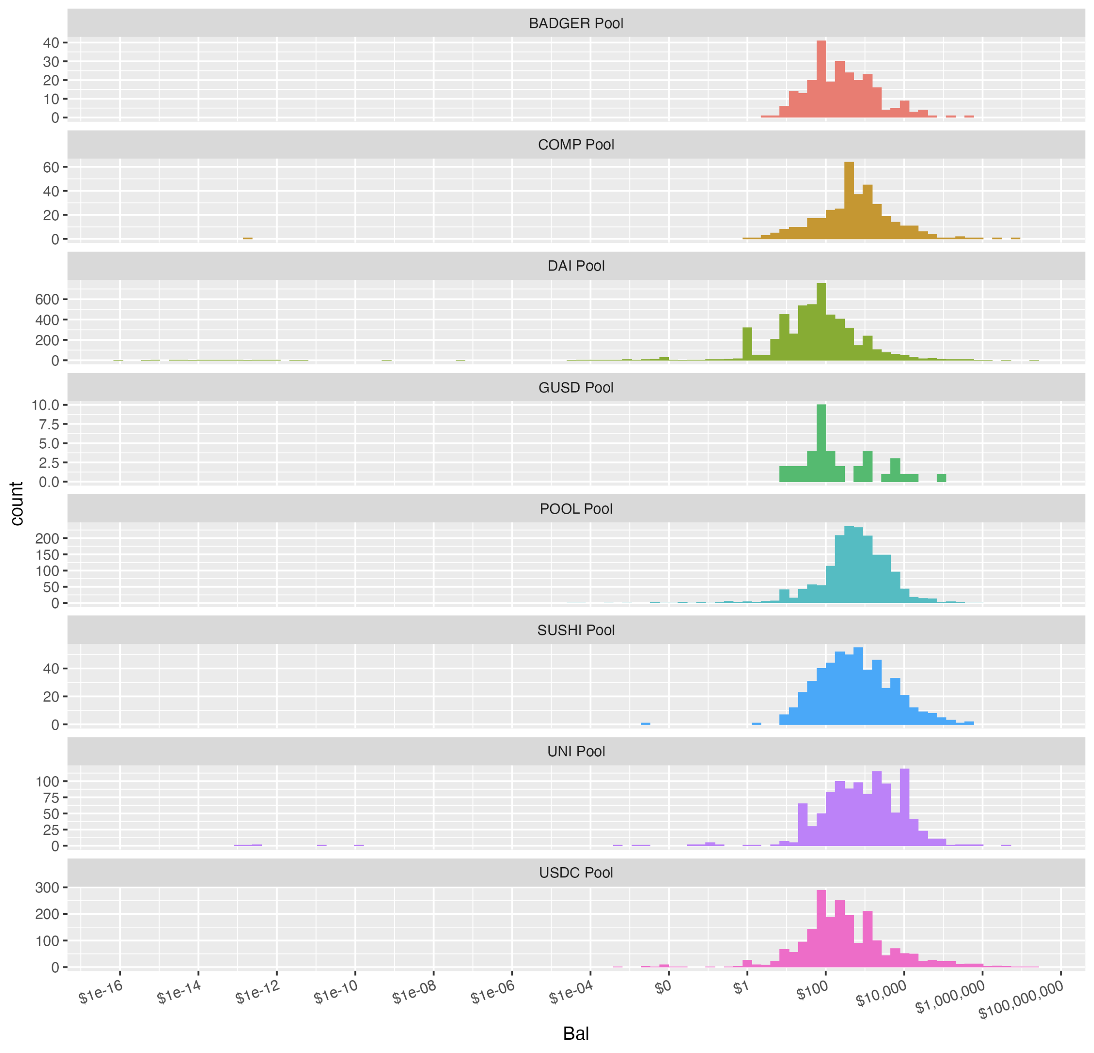

Slide 21
